Slide 1
Displaying a Single Line of Text with Multiple Statements
// Printing a line of text with multiple statements
public class Welcome2
{
\\main method begins execution of Java application
public static void main( String[] args )
{
System.out.print( "Welcome to " );
System.out.println( "Java Programming!" );
} // end method main
} // end class Welcome2

Slide 2
Displaying Multiple Lines of Text with a Single Statement
\\Printing multiple lines of text with a single statement.
public class Welcome
{
// main method begins execution of Java application 7
public static void main( String[] args )
{ System.out.println( "Welcome to Java Programming!" );
}
// end method main
} // end class Welcome3

Slide 4
Displaying Text with printf The
The System.out.printf method (f means “formatted”) displays formatted data. Figure 2.6 uses this method to output the strings "Welcome to" and "Java Programming!

Slide 5
Output
System.out.printf( "%s\n%s\n",
"Welcome to", "Java Programming!" );

Slide 6
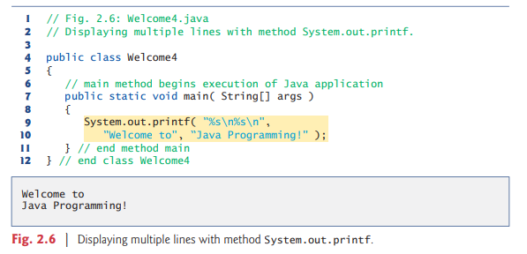

Slide 7
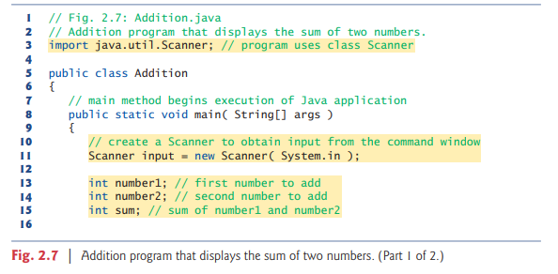
Another Application: Adding Integers

Slide 8
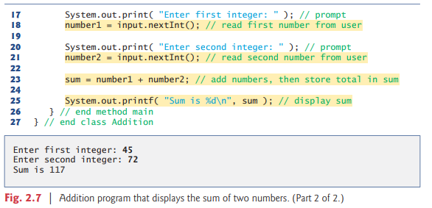

Slide 9
Import Declarations
A great strength of Java is its rich set of predefined classes that you can reuse rather than “reinventing the wheel.”
These classes are grouped into packages—named groups of related classes—and are collectively referred to as the Java class library, or the Java Application Programming Interface (Java API).
import java.util.Scanner; // program uses class Scanner
is an import declaration that helps the compiler locate a class that’s used in this program.
It indicates that this example uses Java’s predefined Scanner class (discussed shortly) from package java.util.

Slide 10
Declaring and Creating a Scanner to Obtain User Input from the Keyboard
A variable is a location in the computer’s memory where a value can be stored for use later in a program. All Java variables must be declared with a name and a type before they can be used.
A variable’s name enables the program to access the value of the variable in memory.
A variable’s name can be any valid identifier.
A variable’s type specifies what kind of information is stored at that location in memory. Like other statements, declaration statements end with a semicolon (;).

